Slide 1
Chatbot for TAAM’s Customers
-primary contact of TAAM

Slide 2
Solution benefits
Responses for frequently asked questions about product, feature, model from customers can be automated
Reduces burden on support
Some obvious questions can be answered at ease.
Offer 24*7 Support

Slide 3
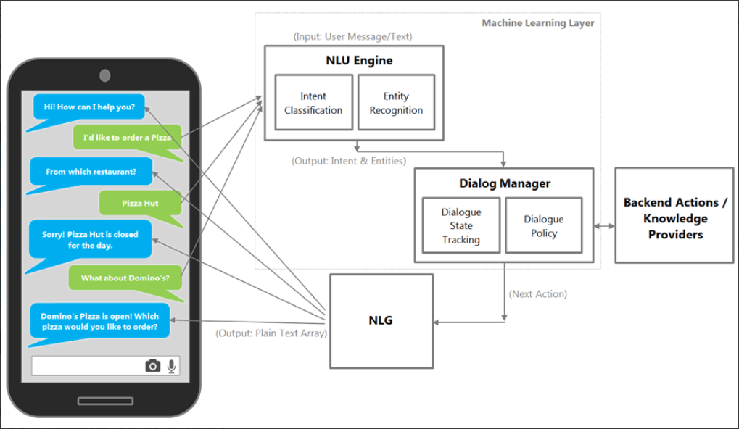
Chatbot architecture

Slide 4
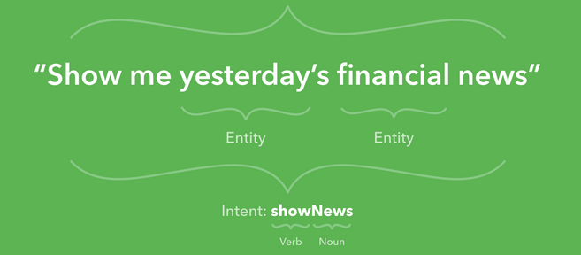
Chatbot architecture – NLU Engine – {Intent and Entity}

Slide 5
Chatbot architecture – Dialogue Manager
Dialogue State Tracker
Maintains Previous Conversation State
Checks if conversation needs to be updated based on intent
Consults Dialogue Policy for further action
Dialogue Policy
High level framework that trains the chatbot
Finds frequently used phrases and builds an engine on top of it

Slide 6
Chatbot Architecture – Backend Knowledge Providers
JIRA
Reference Manual
Structured Data
Unstructured Data

Slide 7
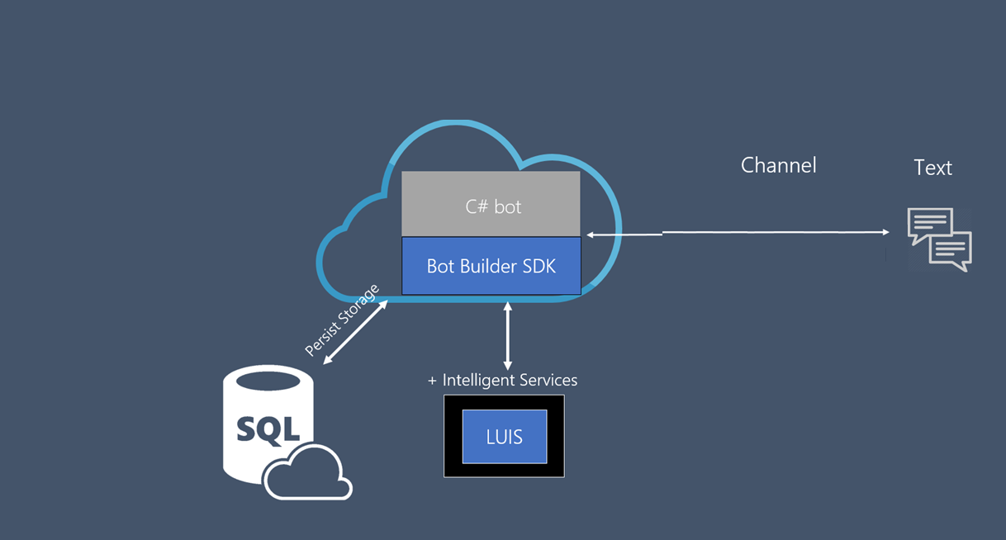
Architecture of Proposed Bot Framework – MS Bot FRAmework

Slide 8
Architecture of Proposed Bot Framework – MS Bot Framework
JIRA (Desk)
TAAM END USER
TAAM BOT
Reference Manual
Pre-fed FAQ

